Slide 1

Resource Request Tracking
(RRT)
The first component of Wildfire One
June 2015

Slide 2
Purpose of this training
Demonstration of the RRT Application for IMB staff
Walkthrough of how IMB staff can use the dashboard
Walkthrough of how to respond to a resource request

Slide 3
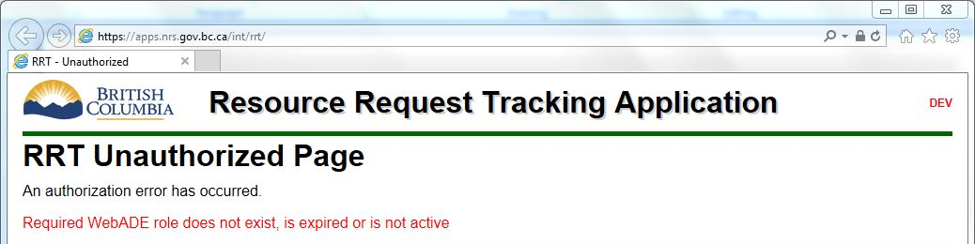
Accessing RRT
Navigate to the Production Applications webpage at https://gww.nrs.gov.bc.ca/flnr/wildfire-management/production-applications
  Training material is also available at this location
If you do not have access, you will see a screen similar to the below.

Slide 4
Two types of Dashboards
“Dashboard” is fixed width and has navigation buttons to get to the other parts of the application. This screen is launched when first accessing the application.
“New Dashboard” is 100% width and does not have menus. You can open multiple copies.
Function is otherwise identical between the two windows.

Slide 5
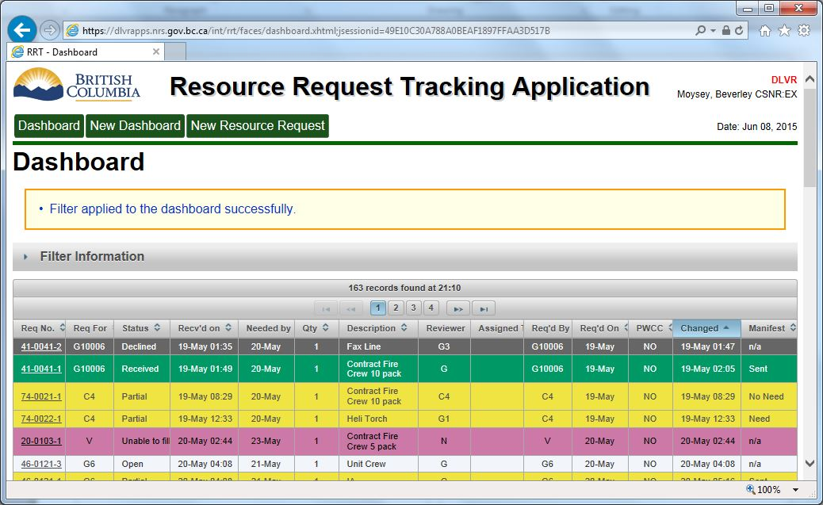
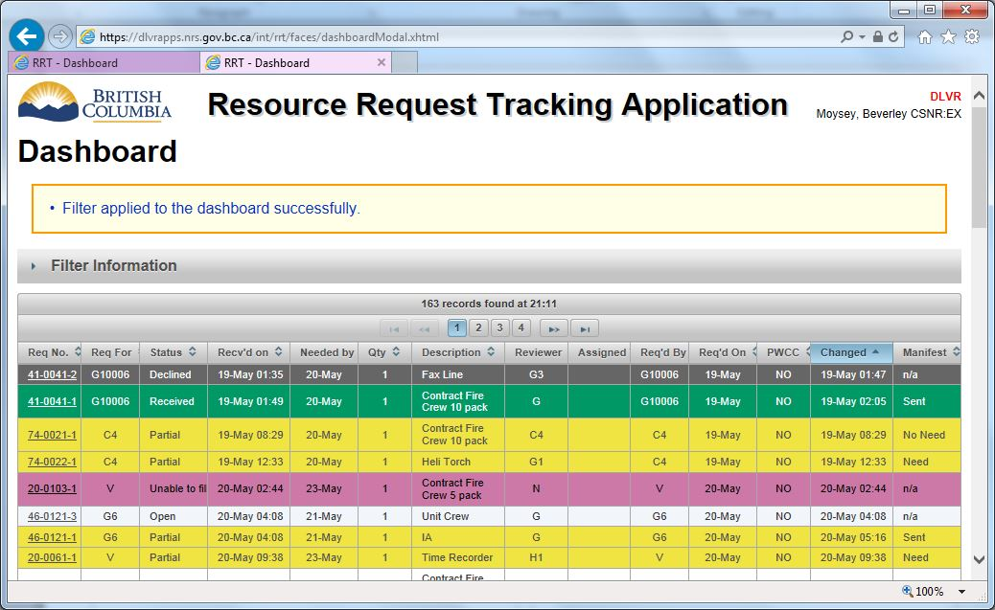
Two types of Dashboards
Dashboard
New Dashboard
Notes:
Note the indication of which environment you are in at top right: DLVR (Delivery), TEST, or PRODUCTION. For testing a new version, use DLVR. For training a new user, use TEST. For real work, use PRODUCTION.

Slide 6
Using filters
To find the RRs that are waiting for your attention, filter by “Current Reviewer”
  Note that “Child” organizations are NOT included, it is an exact match only
Save filter if desired, or simply “Update Dashboard” to see results without saving
You may collapse the filter section by clicking on its header after you’ve set it.

Slide 7
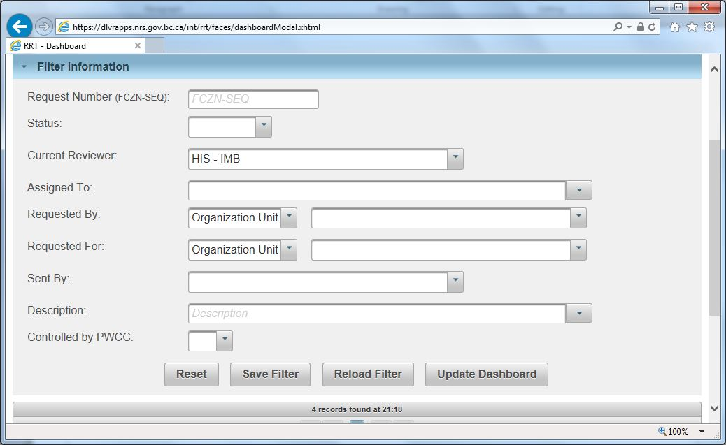
Using filters

Slide 8
Responding to a Resource Request
Click on the RR number on the Dashboard to open the Process Request screen
Claim the RR by entering your name in the “Assigned To” box and clicking Save. This sets the RR to “Pending” state.
When ready to process the RR, add a Response.
If request is now fully filled, select the action “Mark Filled” and click “Take Action” button.

Slide 9
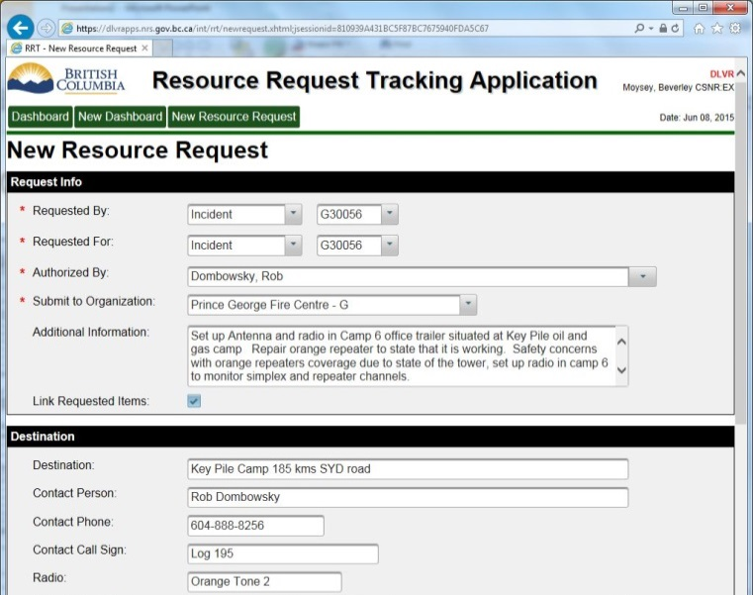
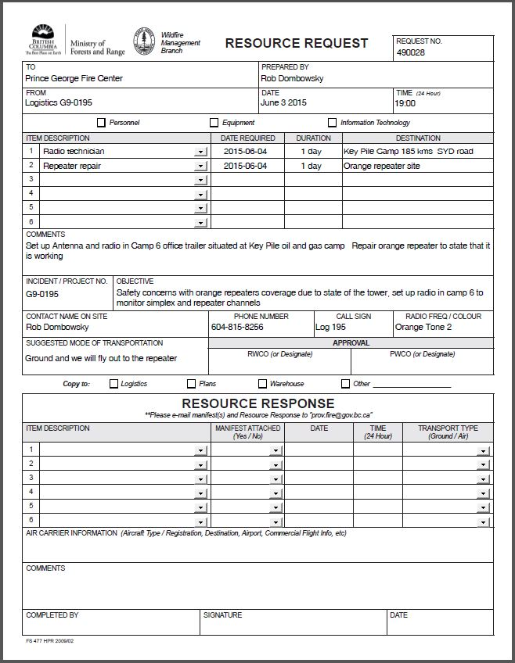
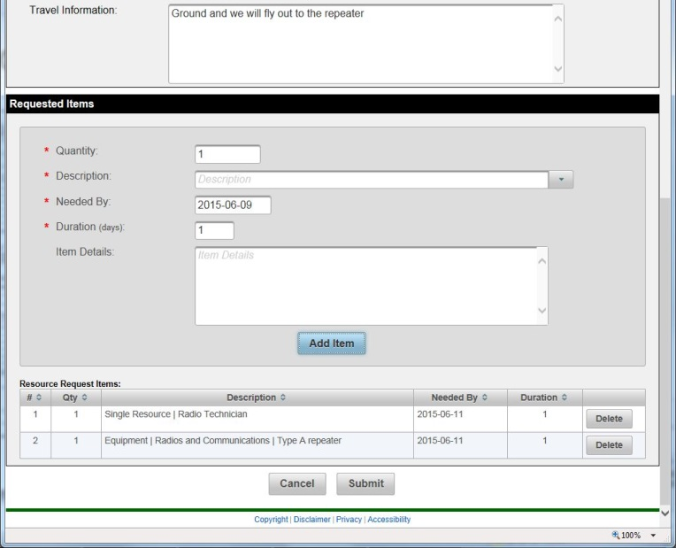

Comparison of PDF and RRT

Slide 10
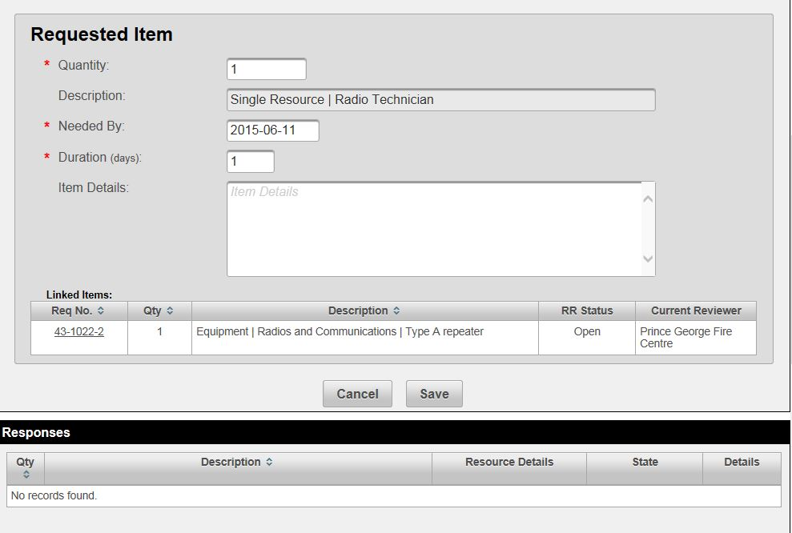
Request Received with linked items
Note linked items

Slide 11
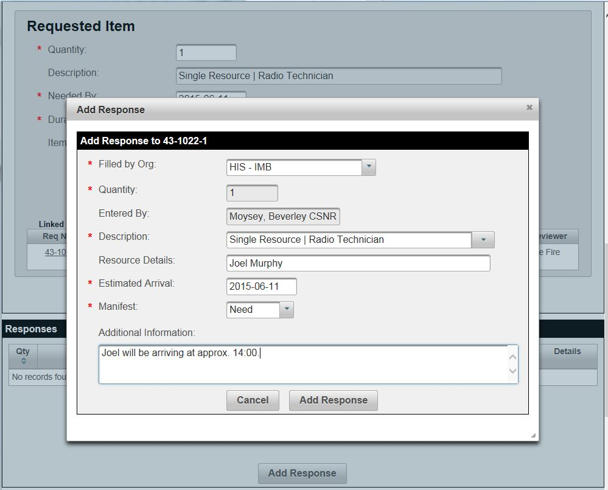
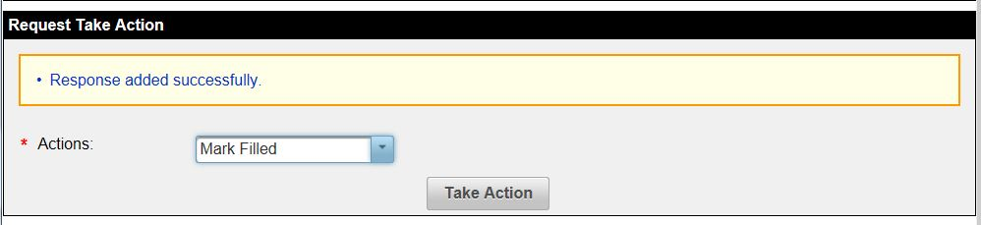
Adding a response and marking request as filled

Slide 12
Not able to fill a request
If you are unable to fill a request, use the “Unable to fill” action if you are the end of the line.
Otherwise, escalate it to PWCC using the “Send to fill” action and specifying PWCC as the receiving organization.

